Slide 1




Slide 2


4 WAYS TO WIN ONLINE
WITH YOUR BUSINESS
Website
Adwords
SEO
Measure Everything

Slide 3





WEBSITE
50% Of Websites in Ireland
are not mobile responsive
You will have one of the best
websites in the country
Our Websites are wordpress built
Wordpress is an open source content
management system which can have
multiple users who can easily
update the content.
Envato Marketplace has purpose
built themes that are high quality
and easy to implement.
To Combat This
we are Offering
50% off Website
Revamps
Today Only
Over 50% of Website Users are on mobile
The site is not optimized for them

Slide 4
ADWORDS
Now that we have a great website,
It's time to get some traffic to it.
Google Adwords is the most effective advertising platform in the world.
I've seen tens of people double their business leads in the first month with Adwords.
It allows you to get to the top of page 1 from the very first day.

Slide 5
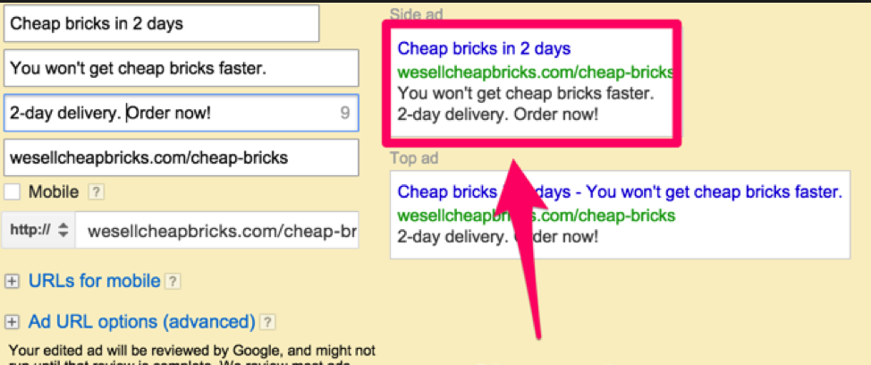
ADWORDS
Ads Consist of:
2 Headlines - Who we are
& And A Call To Action

Slide 6
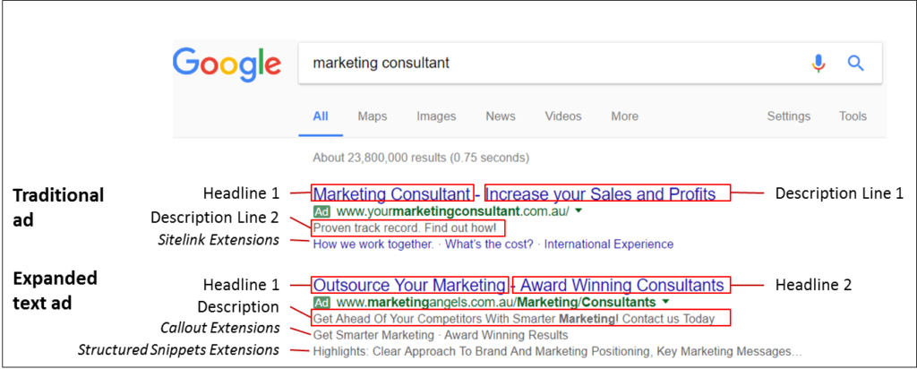
ADWORDS
Ads Consist of:
Description: Describe the
service you are offering

Slide 7
ADWORDS
Ads Consist of:
Callouts: Highlights and
unique selling points
of your business

Slide 8
ADWORDS
Ads Consist of:
Sitelinks: Links to
different pages on
your site

Slide 9
ADWORDS
Ads Consist of:
Structured Snippets:
The different Services or
Models You have to offer
Phone Number, Location,
Price Extensions

Slide 10

ADWORDS
Adwords Is a great model because your ad only shows when people search for your business
and you only pay when they click on your ad

Slide 11
SEO
Search Engine Optimisation:
This is the process of Showing up high on the first page of Google for free. It can take 6-12 months depending on a number of factors including the age of the domain and its authority.
The Map is generating by having a Google My Business account and you can often select a strategic keyword and be the only business to show a my business for that keyword.
The Organic or free listings are the Listings that sit just under the Ads. Getting to the top here can have a profound impact on your bottom line.
This is achieved by building a complete link profile of your business online.
The Structure of your website, Blogging, Directories, Microsites Are effective ways of getting to the top of the search results.
You need to have a landing page for every service you provide that people are searching for.
Make it as easy as possible for them to become paying customers

Slide 12
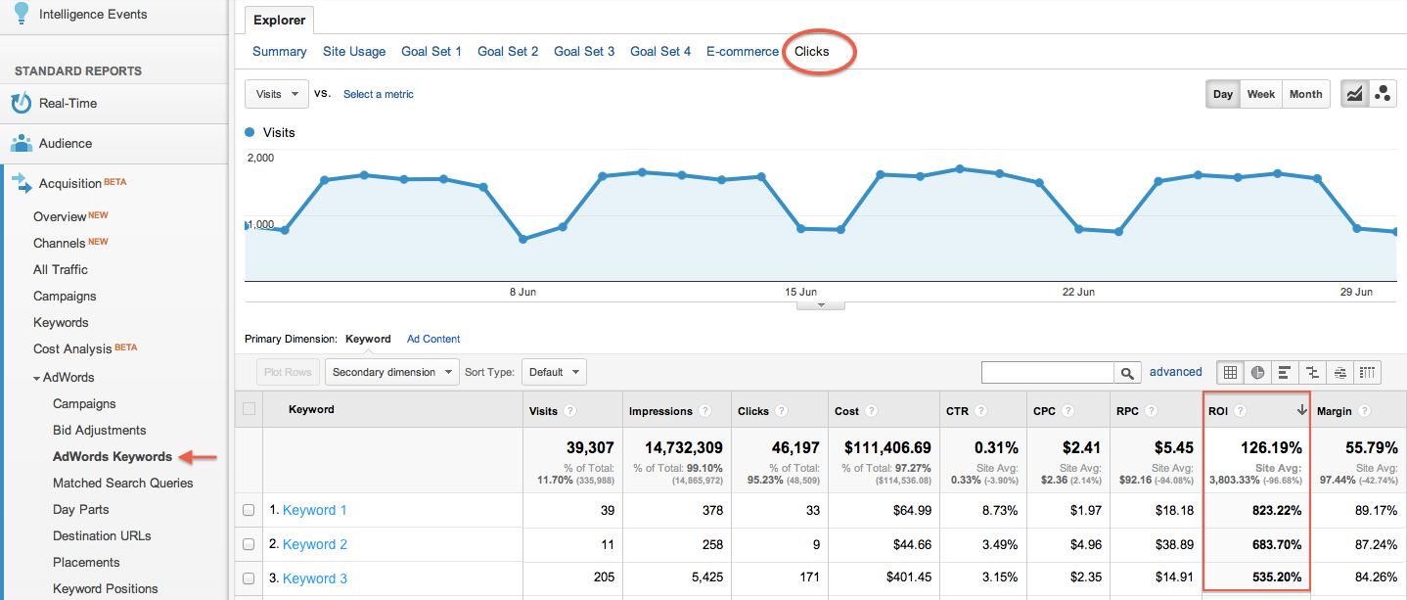
MEASURE EVERYTHING
Measurement: Analytics & Tag Manager
How many people are visiting your website every day, What pages are they visiting, what devices are they using and what important actions are they taking?
What gets measured gets improved.
Tag manager is a central repository for all of your Tags and allows multiple people to collaborate without going into the websites code. One tag is installed and you can do the rest from Tag Manager which is extremely handy for your organization.
Setting up goals for your adwords campaigns and for analytics allows you to measure the success of every channel.
More importantly, it allows you to focus on what is working and maximize your success online.

Slide 13
RECAP:
Website:
Has to be mobile responsive, Include attractive stick photos, A Landing Page for every service, all contact information and plenty of calls to action. Wordpress is best and we are offering 50% off revamps for today only.
Adwords:
Most effective Advertising Platform in the world. Only show to your target market unlike traditional advertising methods. Only pay when they take action and visit your website.
SEO:
Get to the top of the free listings to increase your bottom line.
Get on the map, get the reviews and get to the top of the free listings.
Tag Manager/Analytics:
What gets measured gets improved.
Analytics shows who is visitng, what devices they are using, what pages they visit and what imprtant actions are they taking on your site, what time of the day etc.
Tag Manager allows you to set up goals and remarketing easily from one central location making management and measurement a walk in the park.

Slide 14
Thank for your time and I'm free
to answer any questions

Slide 15

CONTACT INFO:
Aidan Lehane - CEO & Founder - Pay Per Click Ireland LTD
Phone: 01-9081495, 083-8446258

